Slide 1
1-2.1

Slide 2
1
4
3
6
1
4
7
18
9
20
10
14
17
13
2
5
21
25
28
24
2
5
7
11
15
12
16
3
6
8
19
22
26
23
27

Slide 3
What’s happening?
What are you doing?
What’s going on?
What are you up to?

Slide 4
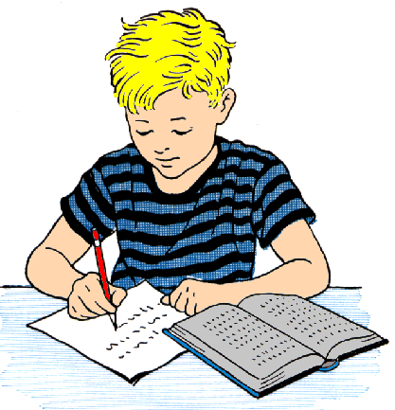
What’s happening?
I am…
studying.

Slide 5
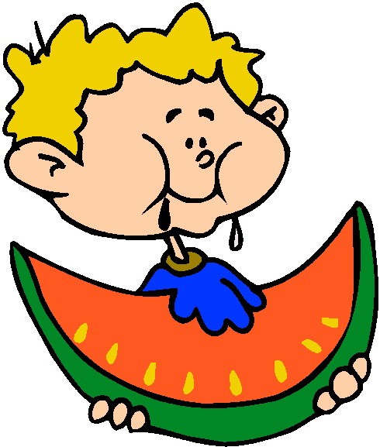
I am …
eating watermelon.
What’s going on?

Slide 6
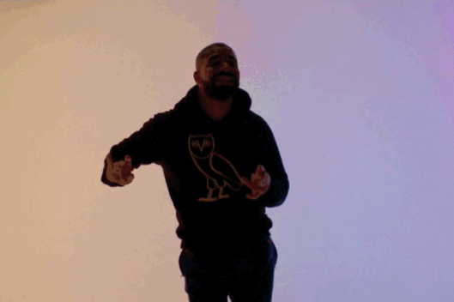
I am…
dancing.
What are you up to?

Slide 7
Busy picture game
Look at a picture for 30 seconds.
Answer the question “What is going on?”
Bet points.
Right: + points, wrong - points

Slide 8
Examples
Team speed game – look at a picture and answer question
I spy – preposition one and she is 뭐ing

Slide 9
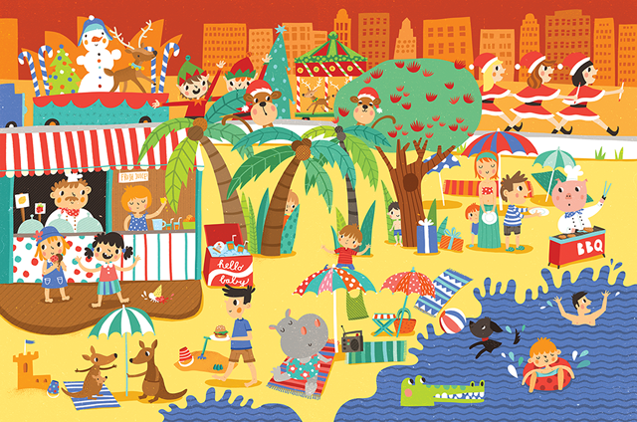

Slide 10
What are you doing?
I am…
cooking
swimming
walking
Picking fruit

Slide 11
What are you doing?
I am…
Drinking juice
eating
talking
studying

Slide 12
What are you doing?
I am…
Selling food
talking
walking
cooking

Slide 13
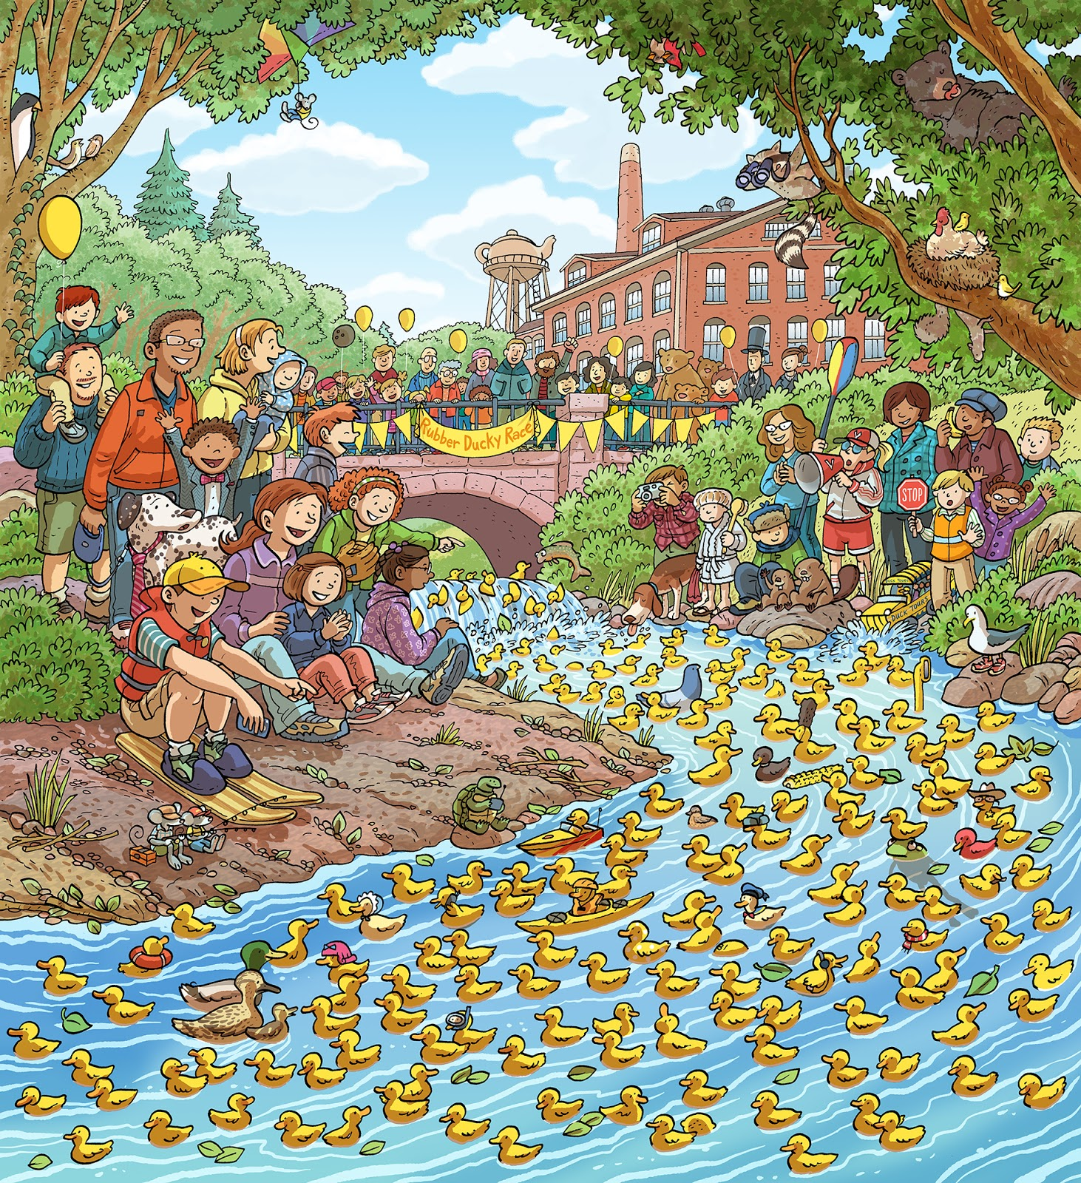

Slide 14
What are you doing?
I am…
showering
swimming
eating
Making a cake

Slide 15
What are you doing?
I am…
sleeping
skiing
talking
Using my phone

Slide 16
What are you doing?
I am…
Playing piano
talking
clapping
Catching a duck

Slide 17
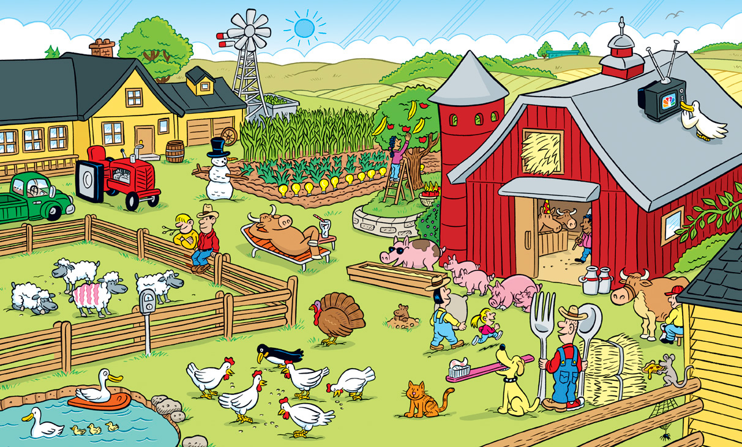

Slide 18
What’s going on?
I am…
Brushing teeth
Playing
Running
Eating

Slide 19
What’s happening?
I am…
What’s going on?
studying
swimming
What are you up to?
Watching TV
eating

Slide 20
What are you doing?
What’s happening?
I am…
What’s going on?
dancing
running
What are you up to?
drawing
eating

Slide 21
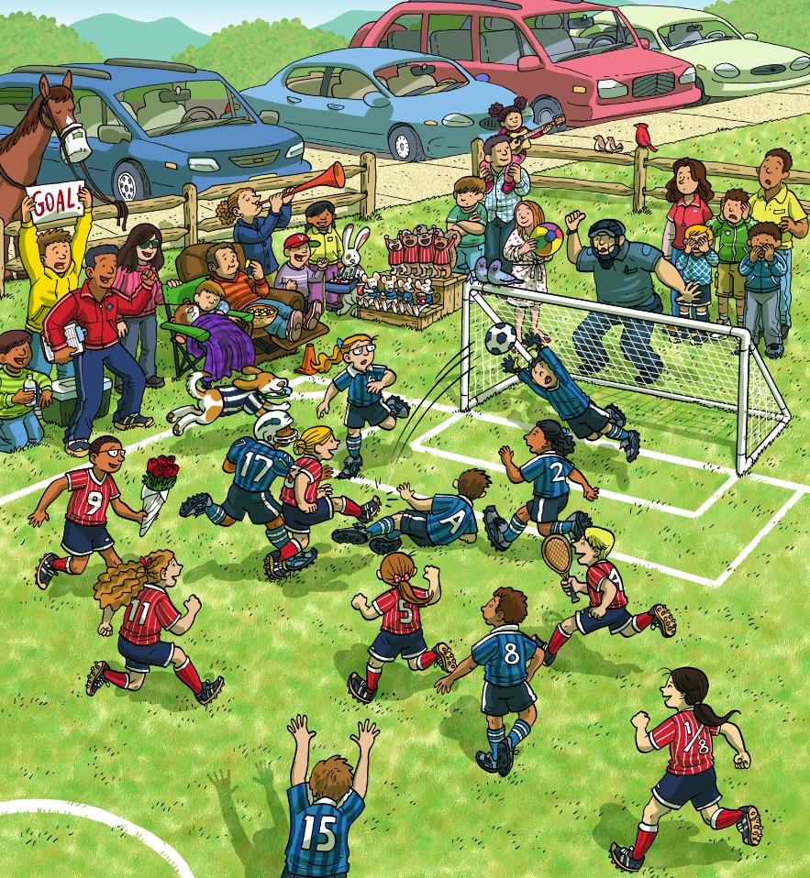

Slide 22
What’s going on?
What’s happening?
I am…
What are you doing?
eating
dancing
What are you up to?
kicking
Watching soccer

Slide 23
What are you doing?
What’s happening?
I am…
What’s going on?
sleeping
driving
What are you up to?
cooking
Playing guitar

Slide 24
What are you up to?
What’s happening?
I am…
What’s going on?
Playing soccer
sleeping
What are you doing?
singing
Watching soccer

Slide 25
What are you doing?
What’s happening?
I am…
What’s going on?
dancing
swimming
What are you up to?
cooking
eating

Slide 26
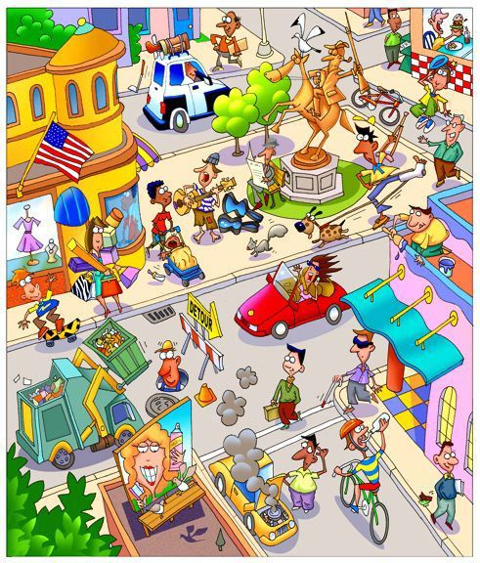

I spy…
(I see)
A man!
He is on the building.
He is painting.

Slide 27


over
on
under
in front of
in back of
in
to the left of
to the right of

Slide 29
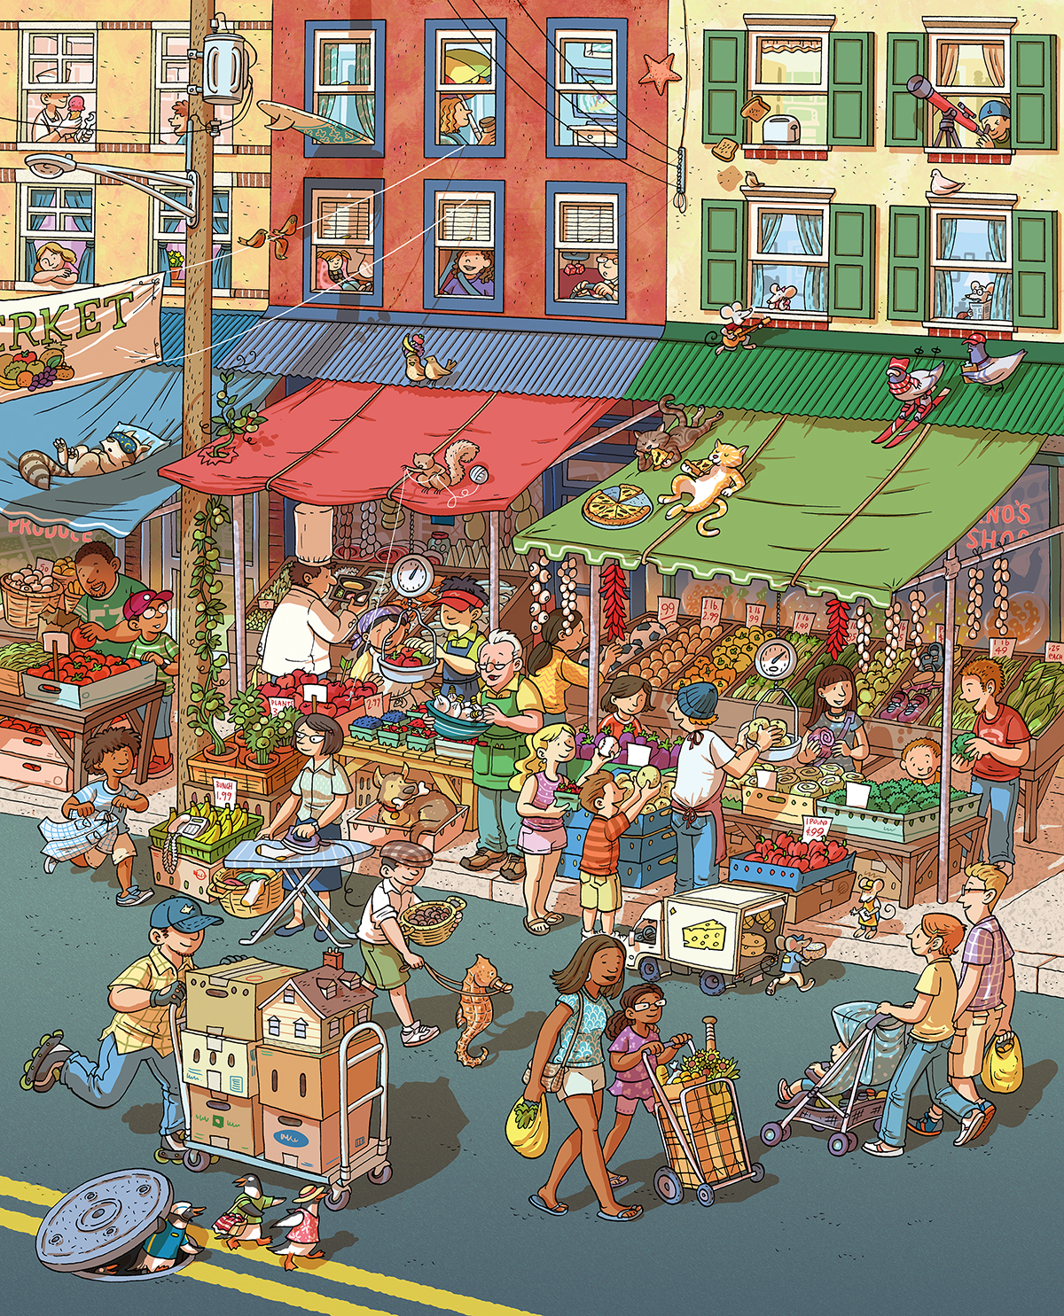

Slide 30
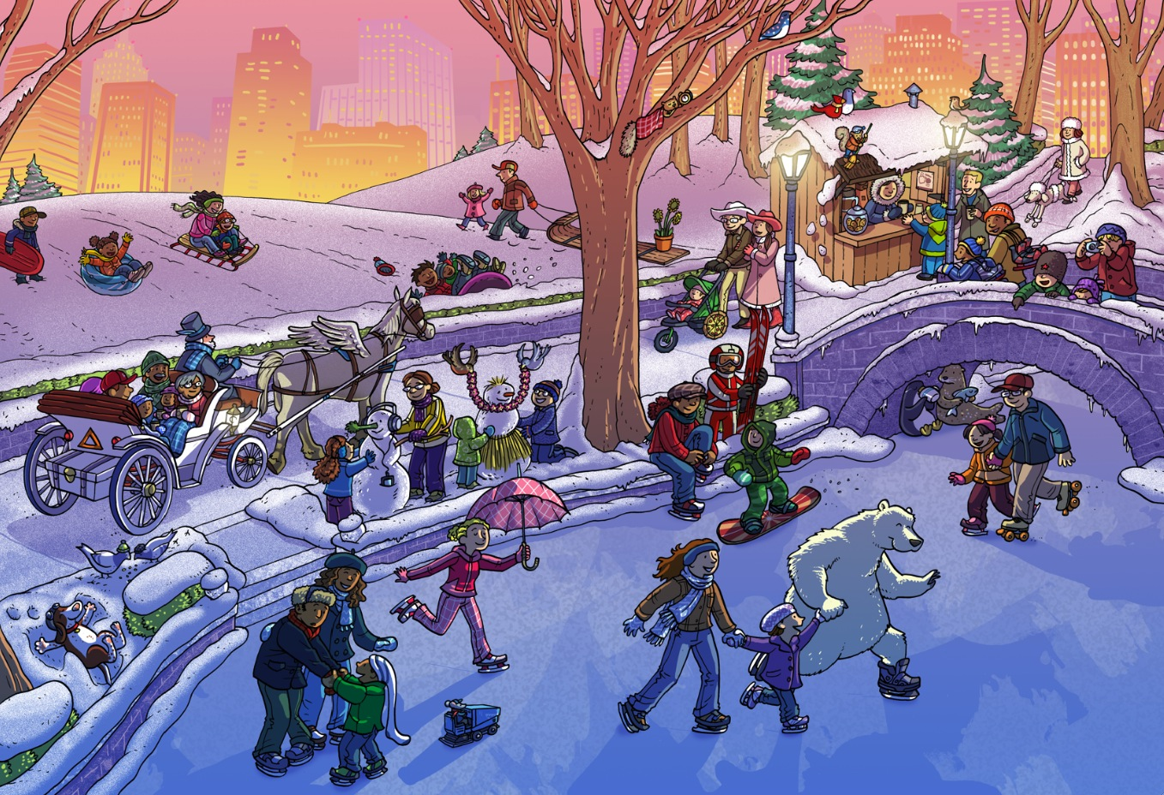

Slide 31
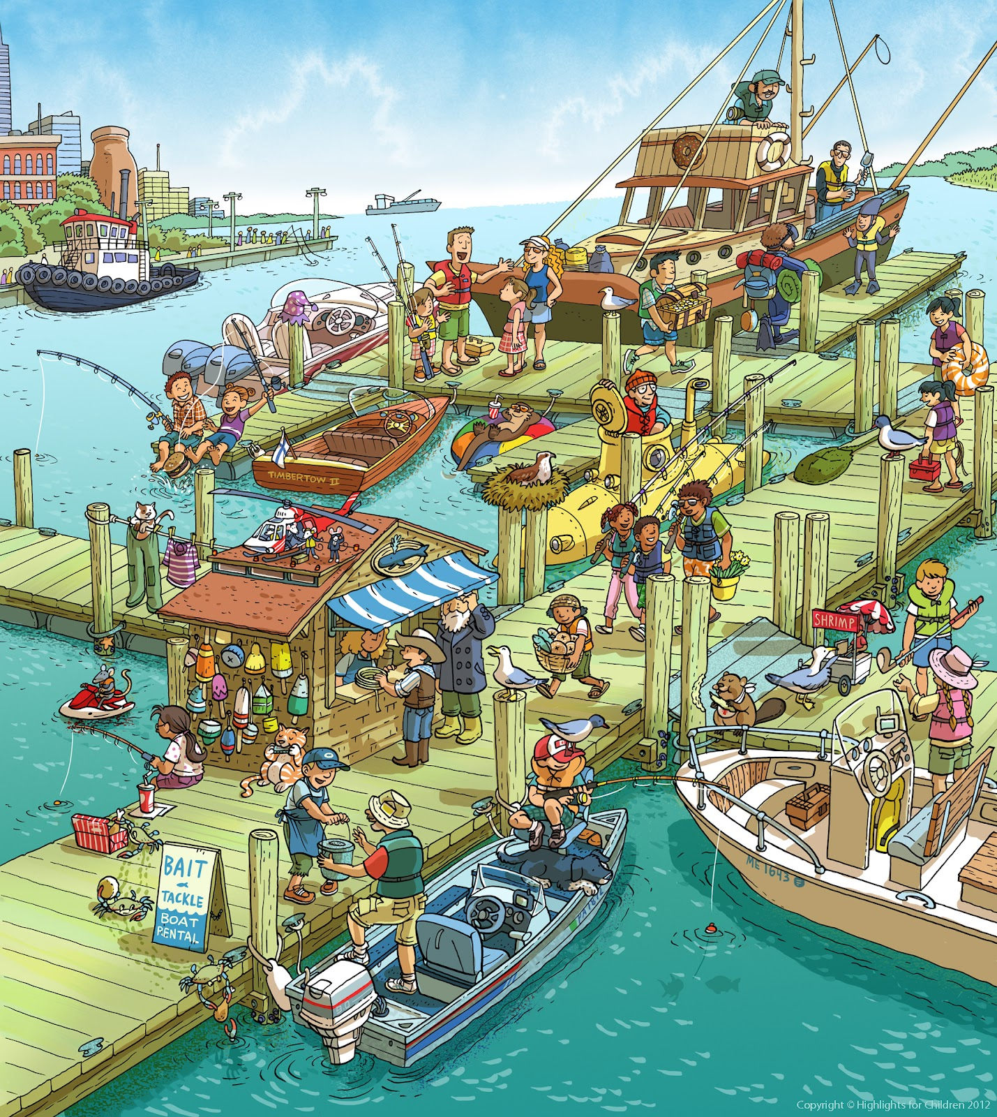

Slide 32
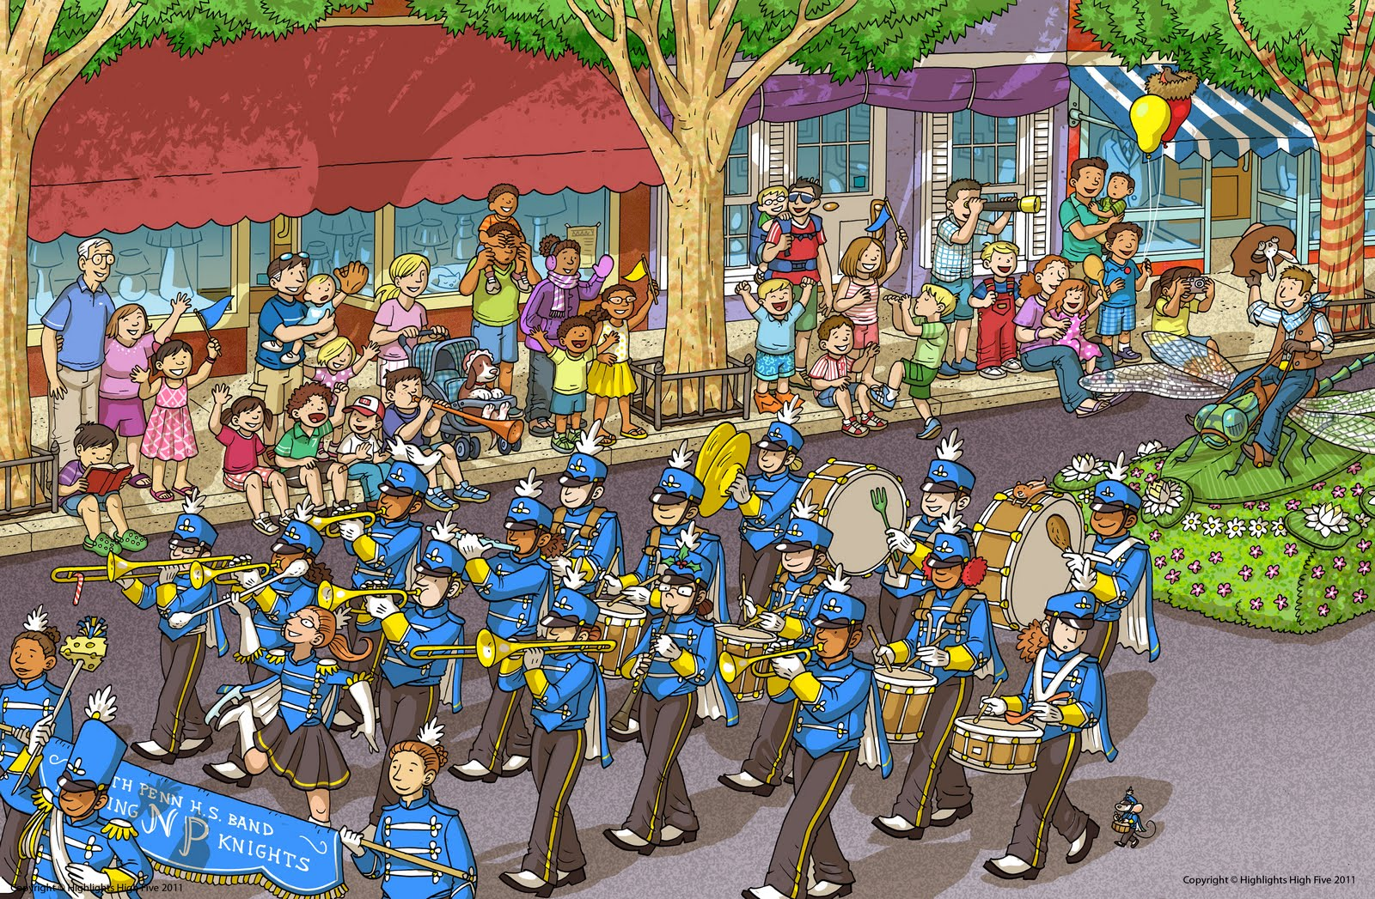

Slide 34
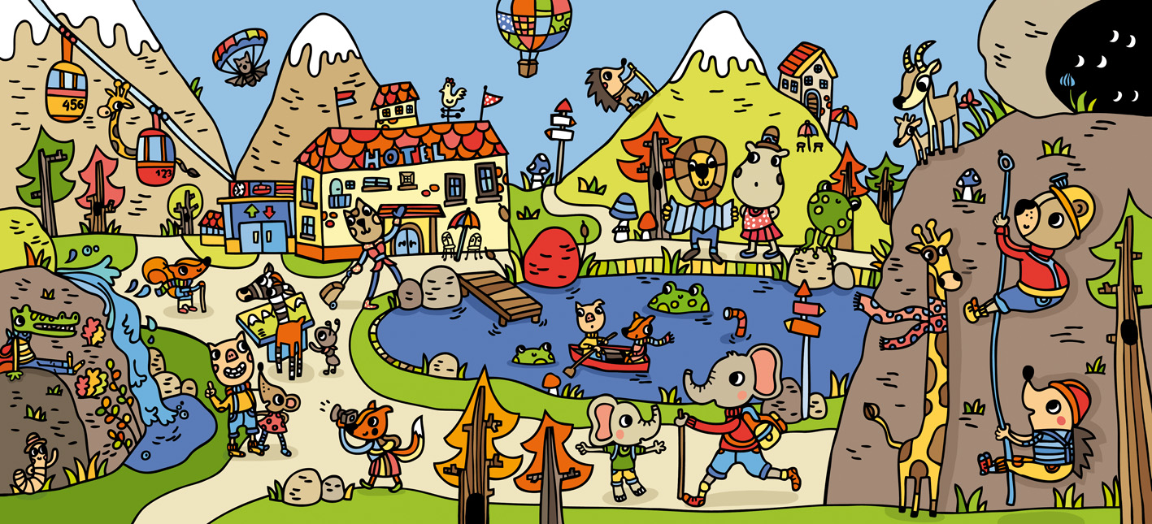

Slide 35
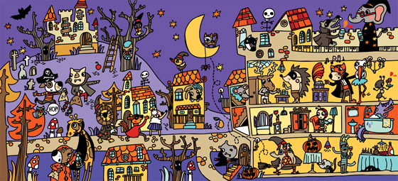
I spy~

